Slide 1
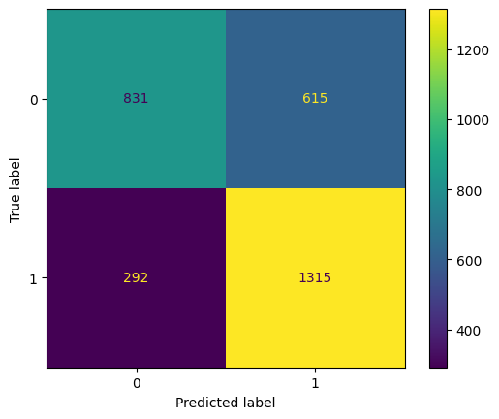
Machine Learning Model for predicting tipping
Is it possible to identify customers who give generous tips?
The income of taxi drivers depends on tips given by their customers. Therefore, to help them increase the amount of tips they receive, it would be beneficial for them to know before accepting to take a customer, whether that customer is likely to give them a generous tip or not.
The purpose of this project was to develop a machine learning model that can accurately predict whether a customer is a generous tipper. A “generous” tip was specified as being 20% or more of the total fare amount.
Two models were trained and evaluated: a random forest classifier and an XGBoost model. The training was carried out with a grid search using cross-validation, using a limited number of features that are mostly related to pick-up and drop-off locations, and the day and time of pick-up.
The two models showed a nearly identical performance for the metrics used:
Model | Precision | Recall | F1 | Accuracy | ROC AUC
Random Forest | 0.682 | 0.816 | 0.743 | 0.703 | 0.697
XGBoost | 0.681 | 0.818 | 0.744 | 0.703 | 0.696
Based on the F1 score of 0.74, both models performed reasonably well.
However, the performance could be potentially improved with further parameter tuning. More importantly, it would be beneficial to collect data regarding customer tipping history, as this is likely a very good predictor of whether a customer will give a generous tip or not.
Confusion matrix of the XGBoost model on test data.
The XGBoost model was chosen as the model to retain. The analysis of feature importance showed that only three features are used by the model: DOLocationID_186, VendorID_2, and predicted_fare. It is unclear how these features provide the best predictive power, particularly the VendorID, which is one limitation of this model.
The XGBoost model can be used to setup a test with a small group of taxi drivers, to determine whether the model indeed helps them get a higher number of generous tips.
Data regarding customer tipping history should be collected and used to improve the model performance.

